Slide 1
SPATIAL ANALYSIS AND CRASH FREQUENCY MODELING IN URBAN AREAS
MS in Infrastructure and Transportation Systems
Mario Alonso Peñaranda Márquez, C.E.
Department of Civil Engineering
Universidad Nacional de Colombia at Medellin

Slide 2
Data Set
The current research is been developed using a crash dataset provided by the Department of Transportation (DOT) of Medellin, occurring during 2016 to 2019.
The database is composed of 178,320 records in the city of Medellin.
Variable | Description
ID | Unique crash record
Time-related | Date and hour
Accident type | Collision, conflagration, occupant fall, rollover, run over
Accident severity | Dead, injured, property damage
Vehicle type | Bus, automobile, bicycle, motorcycle, quadricycle, among others
Type of facility | Crosswalk, intersection, road segment, roundabout, among others
Driver-related | Gender and age
Localization | Crash address

Slide 3
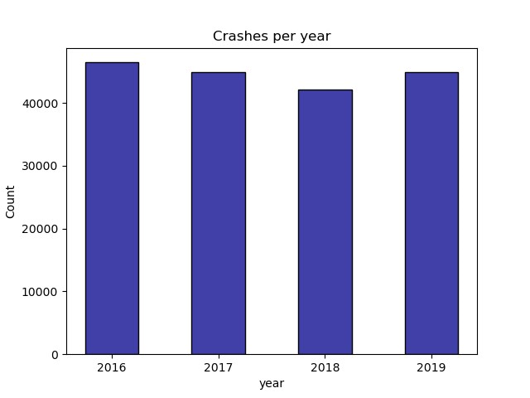
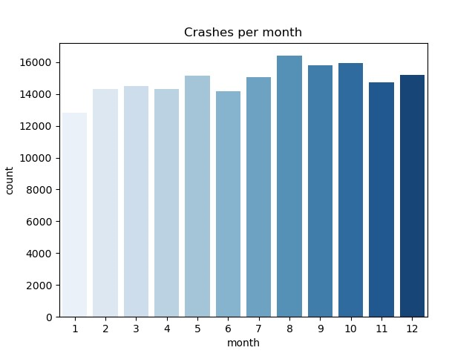
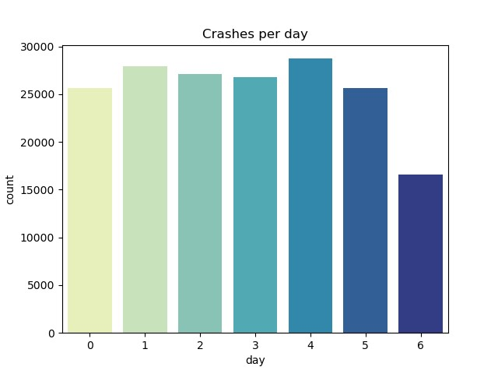
Data Description

Slide 4
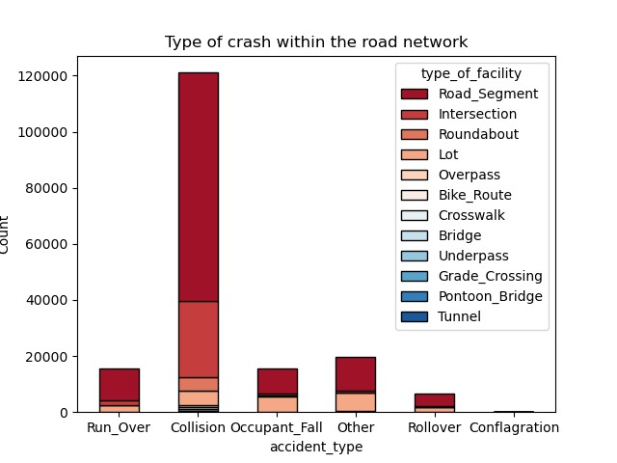
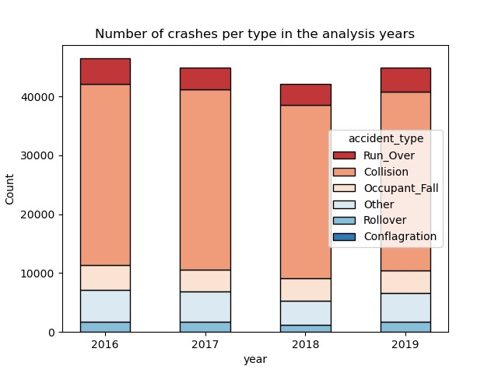
Data Description

Slide 5
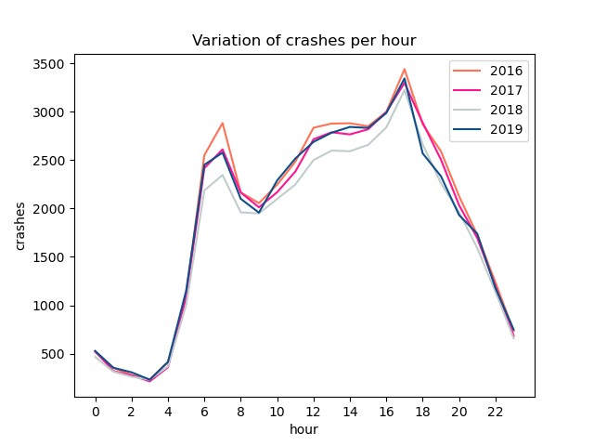
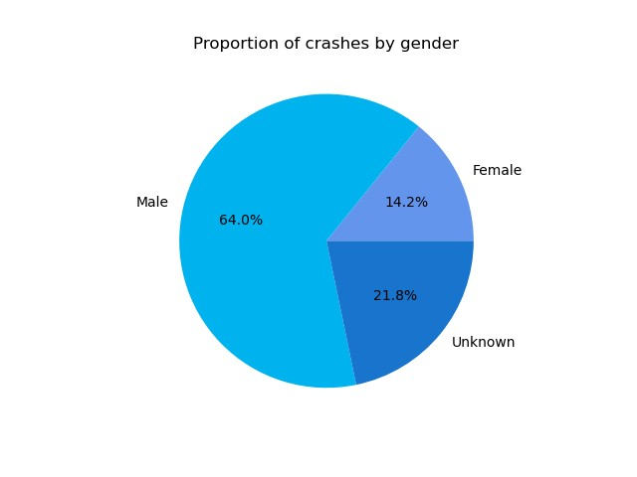
Data Description
Auto brand | Crashes
Chevrolet | 5.586
Renault | 4.405
Hyundai | 3.477
Mazda | 1.974
Kia | 1.698
Nissan | 817
Ford | 608
Volkswagen | 468
Suzuki | 262
Toyota | 258
Moto brand | Crashes
Bajaj | 3.615
Yamaha | 3.601
Akt | 2.637
Kymco | 1.598
Honda | 1.133
Suzuki | 567
Auteco | 558
Tvs | 257

Slide 6
Data Cleaning
For spatial analysis, tidy data is needed → duplicate values removed.
New variables were computed:
Quantitative variables → number of vehicles, and average age of the drivers.
Dummy variables → vulnerable road users (VRU) involved in the crash, such as motorcycles and bicycles. The dataset did not included accidents involving pedestrians.
A temporal segmentation was done considering the following:
Crashes that resulted in injured people.
Between 5:30 and 18:30 hours.
Typical days Tuesday, Wednesday, and Thursday.
Macro-level analysis in 265 neighborhoods as the spatial units.

Slide 7


Data Geocoding
Crash addresses were cleansed to standardize the string structure for geocoding. MapQuest API allows 15,000 free transactions per month and supported the geocoding of them in this project.
Using Python’s osmnx library, the bounding-box coordinates for Medellin were queried from Open Street Maps. Finally, the database for further analysis was composed by 23,079 points in Medellin.

Slide 8
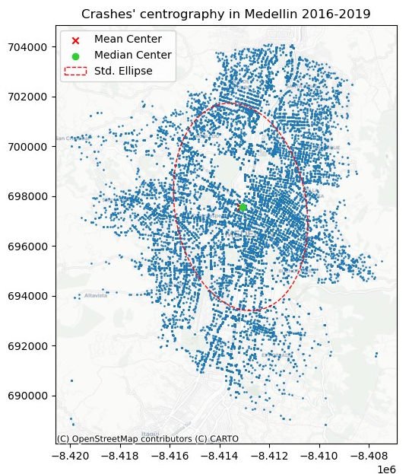
Centrography
Variable | Value
Standard distance | 3,598 m
Major axis | 4,201 m
Minor axis | 2,639 m
Rotation | 0.166
Notes:
Standard distance: it is the average distance away from the center of the point cloud (center of mass). On average, crashes occurred around 3,628 m from the mean center.
Standard deviational ellipse: it reflects both its center and dispersion.

Slide 9
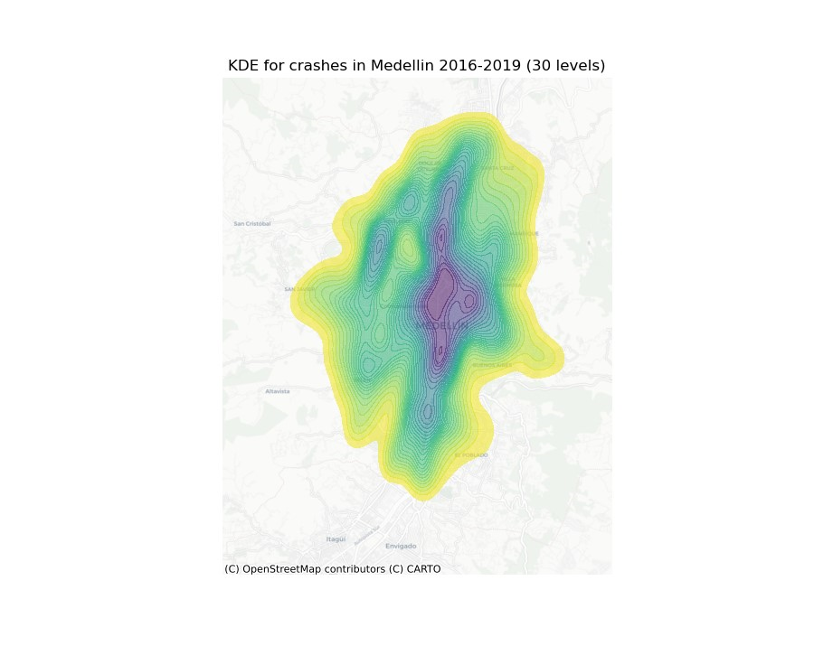
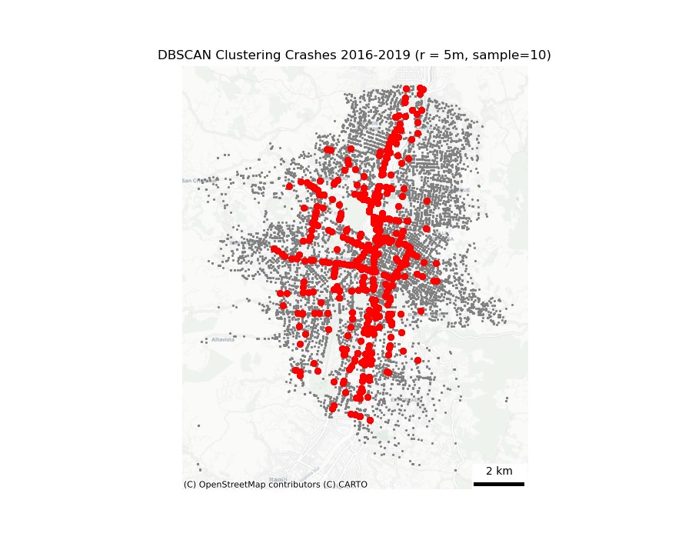

KDE and DBSCAN
Notes:
KDE expresses the concentration of points at each location within the neighboring area. This function assumes that every individual event has an impact on the density in its spatial neighborhood (bandwidth), making use of a continuous, symmetrical, and decreasing probabilistic function through a regression factor that depends on the type of function and the interpolation space surrounding in each point.

Slide 10
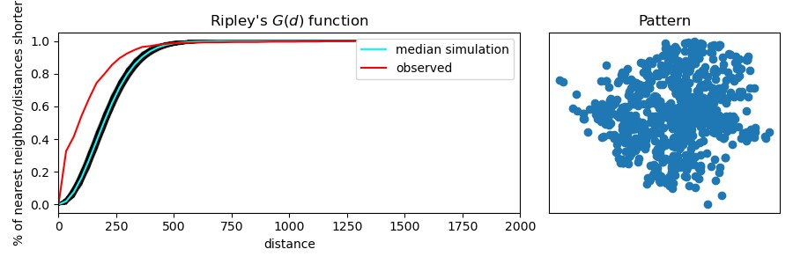
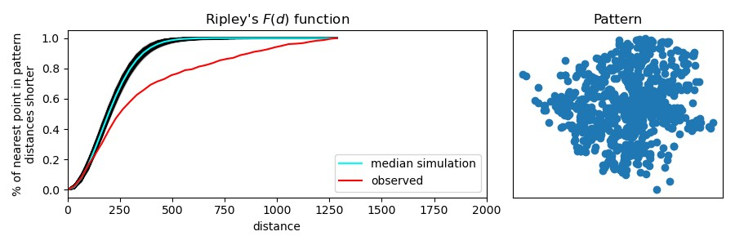
Ripley’s K Functions
Notes:
Ripley’s G function tracks the proportion of points for which the nearest neighbor falls within a given threshold, and its plot illustrate the cumulative percentage against the increasing distance radiuses
It suggests that more than 40% of the crashes have their nearest neighbor within a radius of 50 m and more than 80% less or equal to 250 m. This result is interesting considering that the average length of a block in Medellin is nearly 80 m, suggesting that crashes tend to cluster among blocks.
Ripley’s F function analyses the distance to points in the pattern from locations in empty space, i.e., it characterizes the typical distance from arbitrary points in empty space to the point pattern.
It shows that the observed curve decreases rapidly below the curve of the simulation, so the point pattern has large empty areas. This information supports the fact of clusters within the data.

Slide 11
Assumptions
First-order neighborhood, so queen contiguity was used for the spatial weight matrix. Isolate neighbors might be excluded from the analysis:
La Avanzada (Popular).
Calazans Parte Alta (La América).
El Rincón (Belén).
Aures No. 2 (Robledo).
Projected coordinate system EPSG 3857.
Geographic coordinate system EPSG 4326.

Slide 12
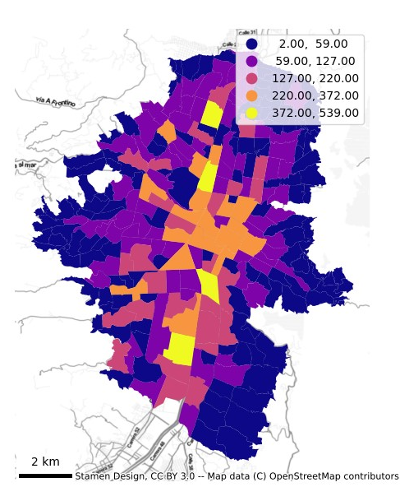
Choropleths (1/4) – Number of crashes in Medellin
Commune | Neighborhood | Crashes
La Candelaria | Perpetuo Socorro | 539
Guayabal | Campo Amor | 501
Castilla | Castilla | 496
 | Caribe | 446
Guayabal | Santa Fé | 372
La Candelaria | La Candelaria | 355
 | San Benito | 350
Laureles | Los Conquistadores | 336
 | Los Colores | 310
 | Carlos E. Restrepo | 309
Neighborhood | Crashes | Saptial Lag
San Diego | 167 | 306
U.P.B. | 23 | 294
Alfonso López | 152 | 284
Cataluña | 36 | 271
El Compromiso | 7 | 257
U.D. Atanasio Girardot | 40 | 257
Santander | 55 | 242
Mirador del Doce | 7 | 227
Parque Norte | 77 | 220
Las Acacias | 150 | 213
Notes:
The OD destination study found that:
6 million daily trips in MMA.
Rush hour between 6-7 and 17-19.
Commuters and students.
La Candelaria is the most visited commune with 723,544 trips (11.8%).
La Candelaria is in the downtown area or the CBD. The importance of it is that nearly 33 tons of freight enter this area daily, accounting for 6,600 freight trips.

Slide 13
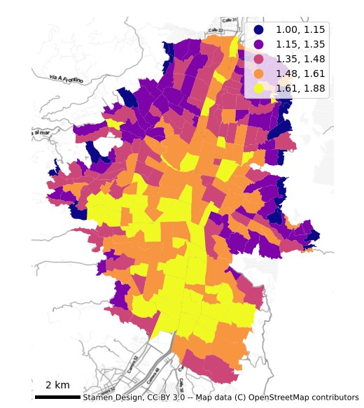
Choropleths (2/4) – Average vehicles involved in crashes in Medellin
Commune | Neighborhood | Av veh
Castilla | Oleoducto | 1.88
Belén | Miravalle | 1.82
Laureles | La Castellana | 1.80
El Poblado | Alejandría | 1.79
EL POBLADO | Villa Carlota | 1.78
Laureles | San Joaquín | 1.75
Belén | Rosales | 1.73
La Candelaria | La Alpujarra | 1.73
Castilla | Belalcázar | 1.72
Popular | El Compromiso | 1.71

Slide 14
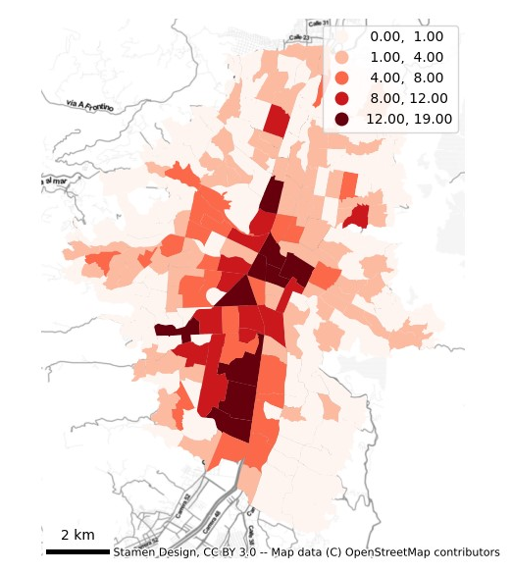
Choropleths (3/4) – Crashes with bicycles involved in Medellin
Commune | Neighborhood | Bicycles in crashes
Laureles | Los Conquistadores | 19
La Candelaria | San Benito | 16
LA CANDELARIA | Guayaquil | 16
LA CANDELARIA | Corazón de Jesús | 15
LA CANDELARIA | La Candelaria | 15
Guayabal | Santa Fé | 14
GUAYABAL | Campo Amor | 14
Castilla | Caribe | 13
Belén | Belén | 13
Guayabal | Cristo Rey | 13
Neighborhood | Bicycles in crashes | Spatial Lag
U.P.B. | 1 | 9.0
Los Mangos | 2 | 8.5
Santander | 2 | 8.5
Los Balsos No.1 | 0 | 8.0
Las Acacias | 3 | 7.8
Alfonso López | 2 | 7.5
El Danubio | 6 | 7.3
La Milagrosa | 0 | 7.3
Parque Norte | 3 | 7.3
La Frontera | 1 | 7.3
Notes:
Medellin has 134.70 km of bike paths and has promoted the use of sustainable transportation modes.
Modal split is supposed to have increased to 3% and the daily trips went up from 60,000 to 210,000.
How ever the network is not full connected.

Slide 15
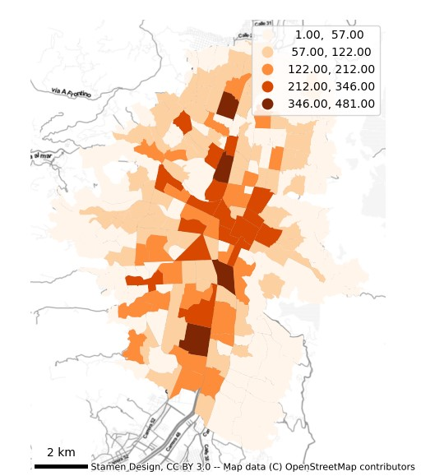
Choropleths (4/4) – Crashes with motorcycles involved in Medellin
Comuna | Neighborhood | Motorcycles in crashes
La Candelaria | Perpetuo Socorro | 481
Guayabal | Campo Amor | 457
Castilla | Castilla | 448
CASTILLA | Caribe | 412
Guayabal | Santa Fé | 346
La Candelaria | San Benito | 316
LA CANDELARIA | La Candelaria | 311
Laureles | Los Conquistadores | 302
LAURELES | Los Colores | 293
LAURELES | Carlos E. Restrepo | 289
Neighborhood | Motorcycles in crashes | Spatial Lag
San Diego | 151 | 272
Alfonso López | 138 | 261
U.P.B. | 19 | 259
Cataluña | 34 | 241.5
U.D. Atanasio Girardot | 38 | 232
El Compromiso | 7 | 232
Santander | 53 | 217
Mirador del Doce | 7 | 209.5
Parque Norte | 69 | 198.6667
Las Acacias | 139 | 194.5
Notes:
The modal split is distributed as follows:
16.2% use transit transportation
12.3% motorcycle
8.1% metro line
13.6% automobile
6.5% taxi
1% bicycle
3.7% others

Slide 16
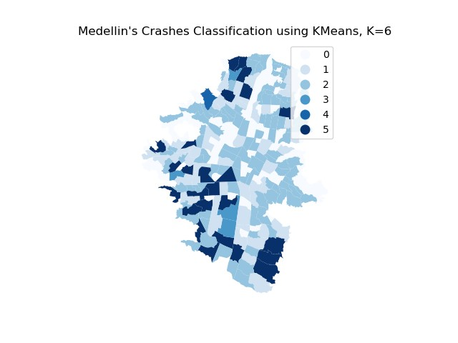
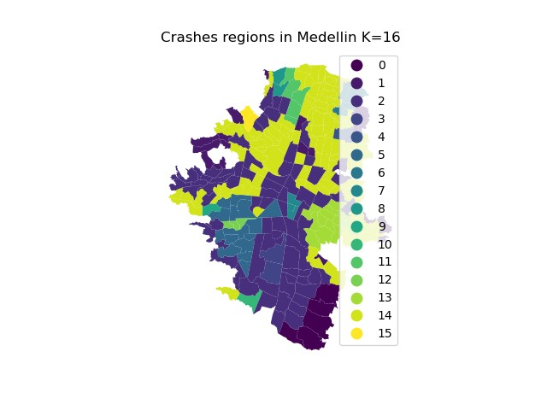
K-Means clustering and Regionalization
Variable | Moran's I | p-value
number_crash | 0.419 | 0.001
aver_veh | 0.510 | 0.001
bici_involved | 0.517 | 0.001
moto_involved | 0.413 | 0.001
Notes:
Regarding the Global Moran’s I, showed in Table 1, it suggests a clear pattern of clustering of the crash records in Medellin
It is noteworthy that the tendency is in the downtown area and through the southern zones:
CBD is crucial for commuters and students, freight transportation.
The Medellin River, major corridors of the city that allow regional connectivity. There are many FTG and conflict between entrances and exits. Max speed of 80 kilometers per hour.

Slide 17
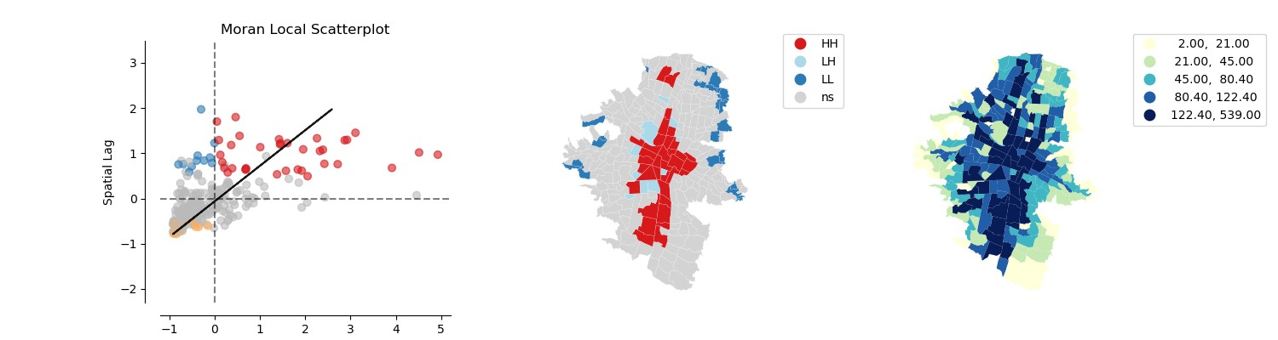
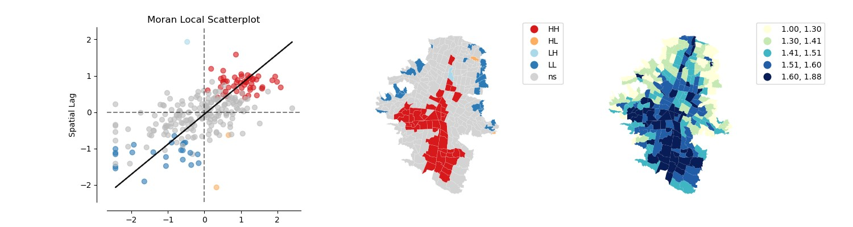
Local Spatial Autocorrelation
Number of crashes
Average number of vehicles
Notes:
A particular case is depicted in the number of crashes, where low-high values are found in Ecoparque Cerro El Volador and Parque Cerro Nutibara, which are two of the seven tutelary hills of Medellin. For obvious reasons, these zones have a low number of crashes within the city.

Slide 18
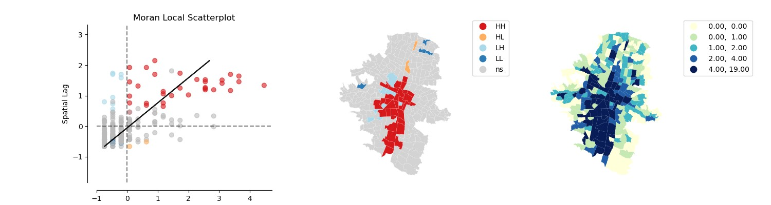
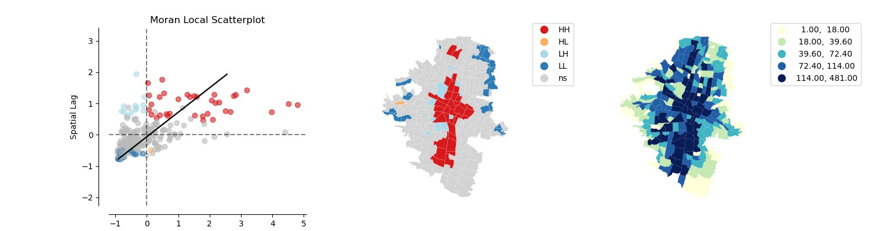
Local Spatial Autocorrelation
Bicycles involved
Motorcycles involved
Notes:
In Figure 10 it is particularly curious that the low-high values are found in U.P.B, Carlos E. Restrepo, and Suramericana neighborhoods. The interesting thing about them is that they have the largest cyclist infrastructure in the city. So, this result suggests that, at least during the analysis period, the reports of crashes involving cyclists were low and the use of bicycles lanes is useful for road safety.
3. Suramericana with 4671 m.
4. Los Conquistadores with 4668 m.
8. Carlos E. Restrepo with 4148 m.
Neighbors of Suramericana:
UD Atanasio Girardot (2,247 m).
Corazón de Jesús (N.A.)
Naranjal (3,639 m)
Cuarta Brigada (2,856 m)
San Benito (N.A).
Neighbors of Los Conquistadores:
San Joaquín (4,301 m)
Corazón de Jesús
Naranjal (3,639 m)
Cerro Nutibara (3,031 m)
Perpetuo Socorro (N.A.)
UPB (2,909 m)
Rosales (3,532 m)
La Alpujarra
Laureles (2,694 m)
Fátima (6,564 m).
Neighbors of Carlos E:
Universidad Nacional (2,104 m).
UD Atanasio Girardot (2,247 m).
Corazón de Jesús (N.A.)
Suramericana
Cuarta Brigada (2,856 m)
Nueva Villa de la Iguaná (3,714 m)
San Benito (N.A).

Slide 19
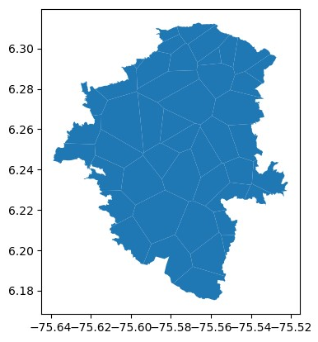
Spatial Regression
The aim is to forecast the number of crashes per neighborhood with a crash frequency model.
Considering that the data tends to cluster, spatial dependence was used.
Spatial Error model.
Additional variables were considered:
Social status
Number of signalized intersections.
Number of control dispositive (cctv, photodetection, and ars).
Daily precipitation.
Voronoi polygons to estimate the action area of 63 pluviometers. Then, it was clip with the map of Medellin, to finally consider 46 zones.
Spatial-temporal merge with the crash records. 13,562 records

Slide 20
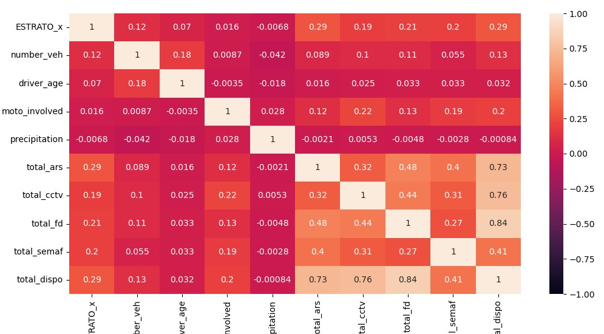
Spatial Regression

Slide 21
Spatial Regression
The chosen model is shown next:
$$C=−0.025∙X_{E}+0.001∙X_{p}+0.008∙X_{s}+0.035∙X_{d}+1.157+0.029$$
The statistical summary:
Variable | Description | Std. Error | z-Statistic | Probability
α | Constant | 0.124 | 92.783 | 0.000
X_{E} | Social status | 0.003 | -6.796 | 0.000
X_{P} | Daily precipitation | 0.002 | 3.187 | 0.001
X_{S} | Number of signalized intersections | 0.009 | 9.442 | 0.000
X_{D} | Number of control dispositive | 0.034 | 11.020 | 0.000
u_{i} | Lambda | 0.029 | 4.292 | 0.000

Slide 22
Thanks!

